Slide 1
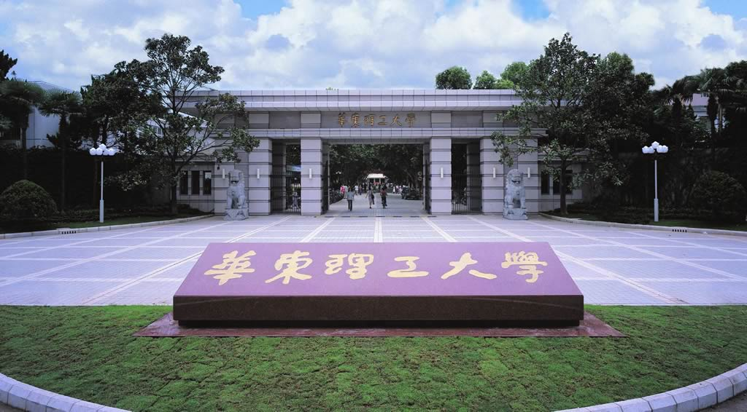
Chapter 7 Techniques for study protein-protein interaction
-- Interaction proteomics
Li-Qiang Fan
East China University of Science and Technolog

Slide 2
Outline
Why study protein-protein interactions？
How to study protein-protein interactions
Experimental methods
Hybrid system
Display system
Affinity-based methods
Computational prediction methods
Cases and application of protein-protein interactions study

Slide 5
Affinity-based Methods to study/identify protein-protein interactions
Methods
Pull-down assay
Far Western assay
Co-precipatation
Affinity purification (immunopurification)
a. One-step affinity purification
b. Two-step affinity purification (tandem affinity purification)

Slide 6
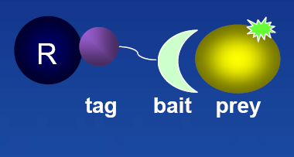
1 Tags Pull-Down ---GST, His, Flag, HaloTag™
One of the most commonly used method for in vitro confirmation of suspected interactions, however screening of novel interactions is also possible.
A resin immobilizes the tagged protein partner which in turn pulls down the interacting protein.

Slide 7
The Pull Down Method
Affinity chromatography method
Using a tagged or labeled (GST, His, Flag, HaloTag™) bait by binding a specific affinity matrix
Purification of a prey protein from a lysate sample or other protein-containing mixture

Slide 8
GST-pull down assays — GTH(glutathione)-GST(glutathione S-transferase) binding
GST
gene X
pGEX
express GST-fusion
protein in E.coli
prepare protein
extract from tissue
Method 1
mix and incubate

Slide 9
GST-pull down assays
GST-fusion protein
GST alone
Sepaharose bead-GTH(glutathione)

Slide 10
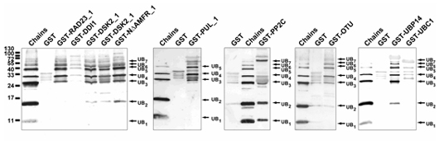
ubiquitin 相互作用

Slide 12
GST pull-down assay
Sepharose
GSH
Sepharose
GSH
“Y”
GST
GST “X”

Slide 13
GST pull-down assay
Method 2
Sepharose
GSH
Sepharose
GSH
GST “X”
“Y”
GST
“Y”

Slide 14
GST pull-down assay
Run Western blot
Sepharose
GSH
Input GST-X GST
anti-Y
GST “X”
“Y”

Slide 15
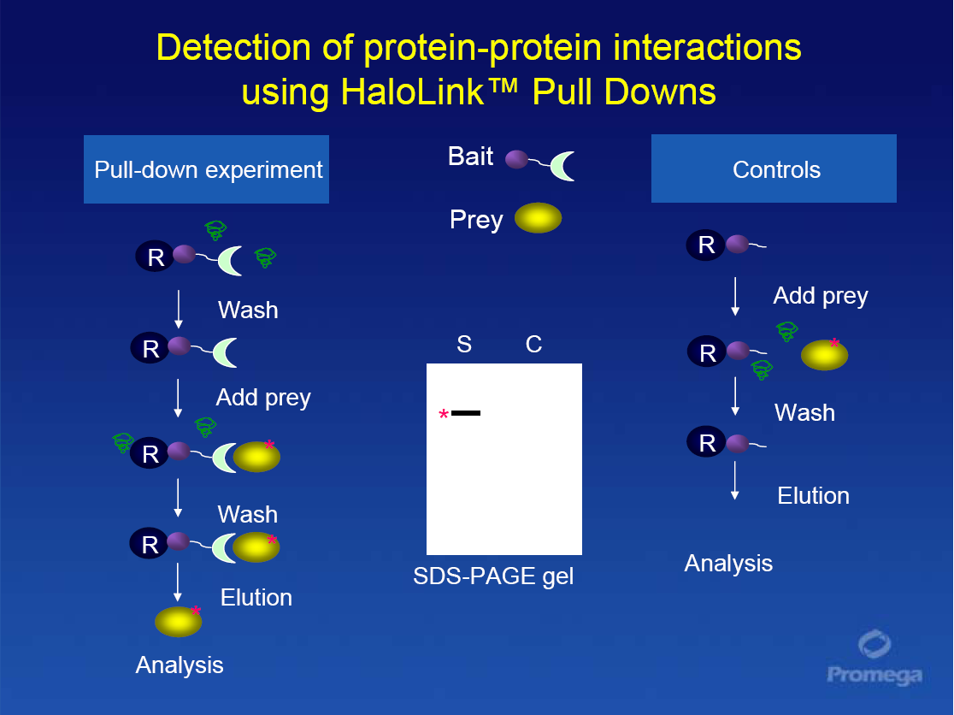

Slide 18
Troubleshooting
Inefficient immobilization of fusion protein
Optimize amount of protein or resin
Binding conditions not optimal (time, temperature)
Proteolysis of protein (add protease inhibitor)
Protein interaction not detected
Weak interaction (co-factors, washing stringency, temperature)
High background
Non-specific interactions
increase number or volume of washes
add BSA and/or detergents
add salt
Reduce amount of prey used or resin

Slide 19
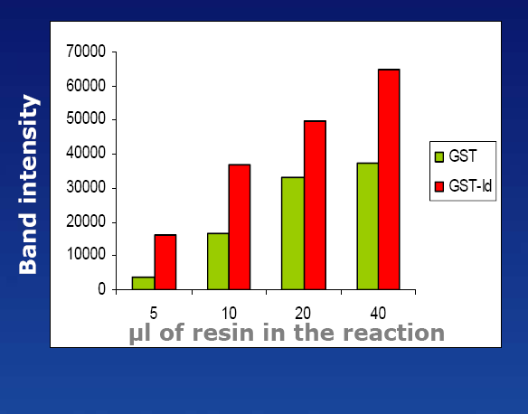
Reducing Non-Specific Interactions GST Pull Down Example
Resin amount

Slide 20
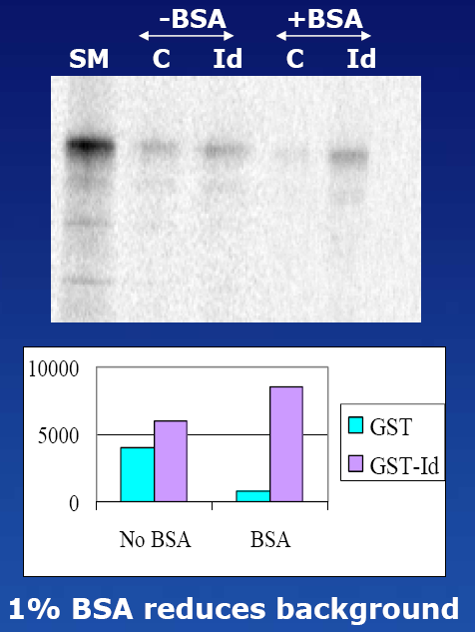
Reducing Non-Specific Interactions GST Pull Down Example
BSA can reduce non-specific interaction

Slide 21
2 Far-western analysis
Similar strategy to Western blotting with one key difference.
The antibody probe in a typical Western blot detection is substituted with an appropriately labeled bait protein as the probe.
To determine receptor-ligand interactions and to screen libraries for interacting proteins

Slide 22
Far-western analysis
Probe-a labeled or antibody-detectable “bait” protein
Target protein-“prey” protein on the membrane
Detection can be radioisotopic, chemiluminescent or colorimetric, depending on the probe label

Slide 23
Far-Western Analysis
GST
Western transfer to membrane and then probe
Purified GST-fusion “bait” protein
Step 2 Probe lysate with GST Fusion “bait” (pure preparation or lysate)
Probe directly in-gel (unblot method)
options
Step 1 separate prey proteins after cell lysis by gel electrophoresis
Chemiluminescent
substrate
light
HRP
Anti-GST
GST
GST
GST-tagged “bait” protein interacting with prey protein in lystate
Step 3 detect interaction with anti-GST and chemiluminescent substrate
Expose to X-ray film or visualize using a CCD camera
Bind represents prey protein in lystate that bound the GST-tagged “bait ”. Interaction detected by chemiluminescent

Slide 24
Co-Immunoprecipitation ---In vivo or in vitro
Immunoprecipitation (IP) is the technique of precipitating a protein antigen out of solution using an antibody that specifically binds to that particular protein.
Immunoprecipitation of intact protein complexes (i.e.: antigen along with any proteins or ligands that are bound to it) is known as Co-IP

Slide 25
Principle
Selecting an antibody that targets a known protein that is believed to be a member of a larger of proteins or an epitope tag fused to one of the protein complex.
By targeting this known member, it may become possible to pull the entire protein complex out of solution and thereby identify unknown members of the complex.
This technique works when the proteins involved in the complex bind to each other tightly

Slide 26
Things should be considered
Obtain a suitable antibody
The antibody should display specificity for the protein target of interest.
The antibody should be capable of immunoprecipitating both the target protein alone and when it is bound to its complex partners(?1)
Antibody exist may complicate analysis and reduce sensitivity for identification of true members of the target protein complex.(?2)
Real interaction(?3)
Notes:
?1 This may be owing either to lack of sufficient antibody specificity (i.e., the antibody reacts with other proteins) or to binding of other proteins to the antibody-recognition site on the target protein. This could occur if a partner of the target protein in the complex “covers up” the antibody-binding site.
?2 linked to an insoluble bead.
?3 By using an antibody to one of the associated proteins for another immunoprecipitation experiment

Slide 27
Require several rounds of precipitation with different antibodies
A particular antibody often select a subpopulation of its target protein that has the epitope exposed, failing to identify any proteins in the complex
The first round of IP often results in the identification of many new proteins that are putative members of the complex. Need to be re-confirm.
Allow for double-check the result.

Slide 29
DNA-protein interaction
Bait approach to identify DNA-interacting proteins
gel shift and supershift
ChIP

Slide 30
DNA-multi protein interaction----gel shift &supershift

Slide 31
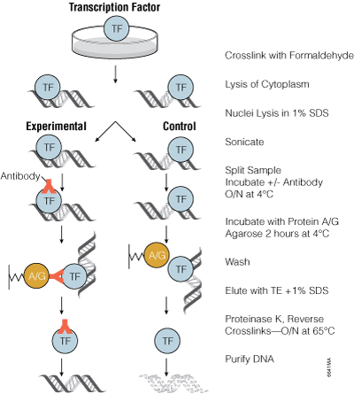
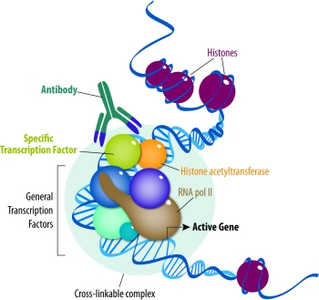
Chromatin immunoprecipitation (ChIP)

Slide 32
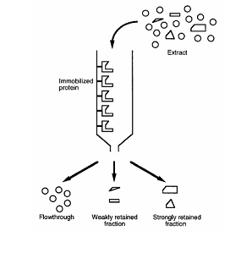
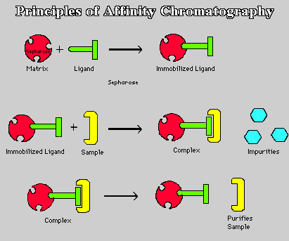
4 Protein Affinity Chromatography

Slide 33
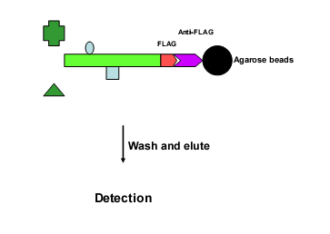
One-step affinity purification

Slide 34
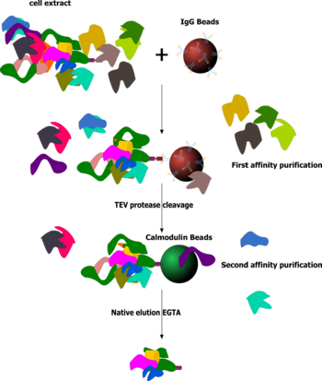
Tandem Affinity Purification (TAP)
A technique for studying protein-protein interactions.
It involves creating a fusion protein with a designed piece, the TAP tag, on the end.
The protein of interest with the TAP tag first binds to beads coated with IgG, the TAP tag is then broken apart by an enzyme, and finally a different part of the TAP tag binds reversibly to beads of a different type.
After the protein of interest has been washed through two affinity columns, it can be examined for binding partners.
Notes:
通过嵌入一段TAP标记连接至目的蛋白的一端，在不破坏目的蛋白的调控序列的基础上市被标记的目的蛋白的表达量能与其细胞中自然表达的水平相当，避免过量表达产生非自然条件下的蛋白质相互作用
联合第一个高亲和纯化、用定位特异的蛋白酶温和洗脱和第二亲和纯化经过特异性的串联亲和纯化，快速得到生理条件下的目的蛋白质存在真实相互作用的蛋白质复合体

Slide 35
Tandem Affinity Purification (TAP) --Two-step affinity purification
Uses 2 consecutive purification steps (2 tags) along with a protease cleavage site to yield intact complexes under so-called native conditions
Uses two tags, and sequential purifications to enhance specificity
Complexes are often studied by mass spectroscopy methods

Slide 36
Tandem Affinity Purification-Mass
Specificity is the major challenge in pull-down assays.
Specificity may be enhanced using sequential tag-captures and specific elutions
In the first round, protein complexes are captured via the first affinity tag (e.g., protein A and IgG Sepharose).

Slide 37
These first-round captures are eluted by cleavage of a specific protease tag
Complexes are recaptured via the second tag (e.g., Calmodulin Binding Domain and Calmodulin-Sepharose).

Slide 38
The second-round complex is then specifically eluted (e.g., by chelation of calcium to disrupt the CBP / Cm interaction)
MS assay

Slide 39
TAP-MS (Tandem Affinity Purification-Mass Spectrometry)
(Guillaume Rigaut, et al. 1999)
(Arnaud Droit, et al. 2005)

Slide 40
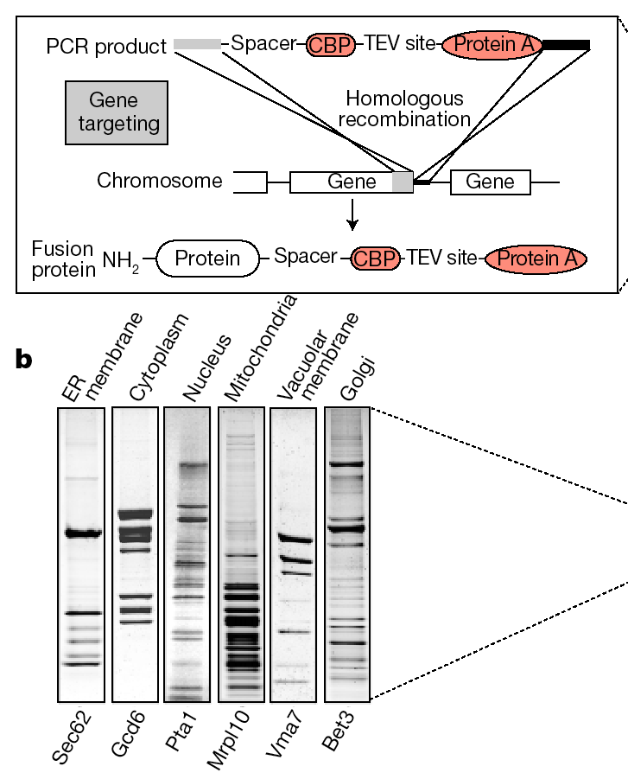
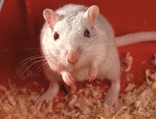
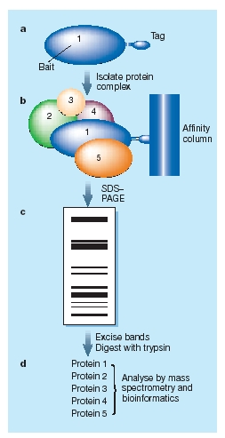
Identifying protein interactions in vivo
Proteomics

Slide 42
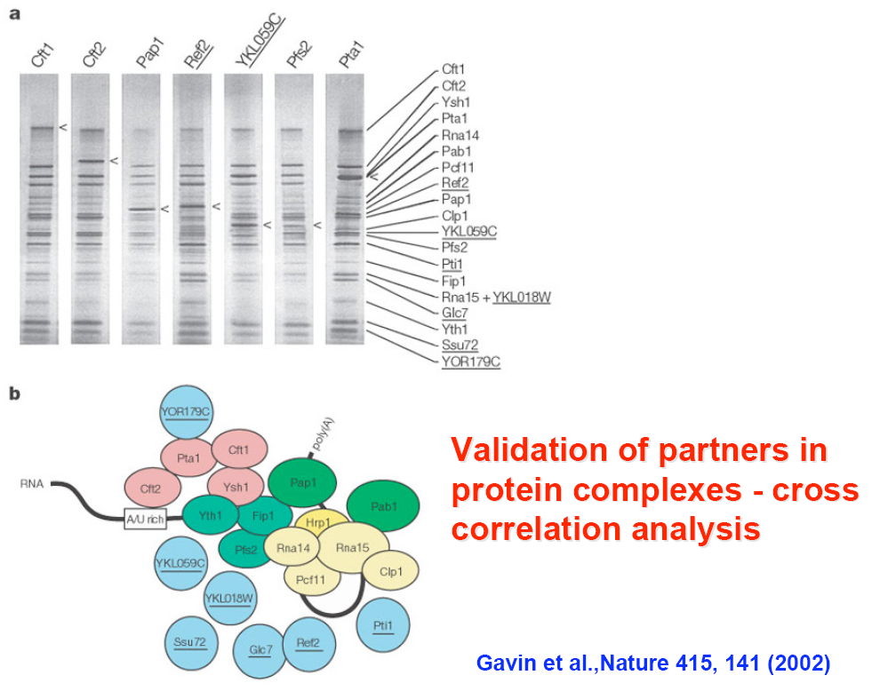

Slide 44
The protein complex network, and grouping of connected complexes

Slide 45
Advantages
Can be real determination of protein partners quantitatively in vivo without prior knowledge of complex composition, activity, or function
Ability to purify low abundant proteins/protein complexes
Fusion of the TAP tag to the target protein
Complex retrieval from tissue culture
Large-scale studies

Slide 46
Disadvantages
A tag added to a protein might obscure binding of the new protein to its interacting partners.
The tag may also affect protein expression levels.
The tag may also not be sufficiently exposed to the affinity beads, hence skewing the results.

Slide 47
Differences and similarities between Y2H and MS-TAP
TAP permits protein complexes to be isolated, but cannot detect weak/transient PPIs
Both methods generate a lot of false positives, only ~50% interactions are biologically significant
Y2H is in vivo technique
MS can detect large stable complexes and networks of interactions

Slide 48
Modifications of TAP
iTAP
Split TAP
Subtraction TAP

Slide 49
iTAP strategy
TAP tagged orthologes from another species
Expression of the tagged protein
RNAi depletion of endogenous version of the tagged protein
TAP purification to identify protein complex

Slide 50
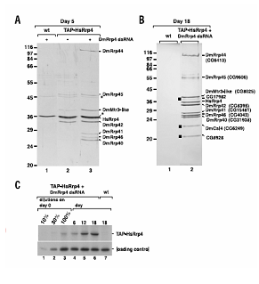
Purification of the Drosophila exosome
TAP-human RRP4 (exosome subunit)
Establish cells expressing the tagged protein
Silence the expression of DmRRP4 by RNAi
Purify the exosome complex
SDS-PAGE and mass spectrometry

Slide 51
iTAP strategy
Demonstrate TAP in higher eucaryotes
Replacement of the original protein by a tagged version and RNAi
The use of native promoter to drive the expression of the tagged protein is still absent

Slide 52
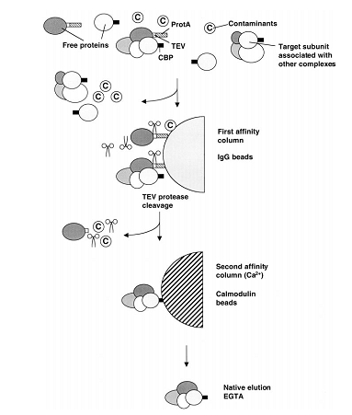
The Split TAP Tag

Slide 53
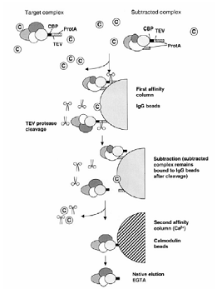
The Subtraction TAP

Slide 54
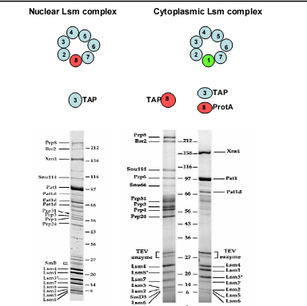

Slide 55
Question
Please list the affinity-based protein interactions study methods and tell their principles.
What are the possible causes of false positive and false negative phenomena in co-precipitation studies? How to avoid them?
Compared with other protein-protein interaction study methods such as yeast two-hybrid, what are the advantages and disadvantages of co-precipitation technology ?
What is tandem affinity purification technology? What is the principle? What are the advantages and disadvantages of this technology compared with other technologies?

